Slide 1

Open SOURCE textbooks
Mathbook XML and improving the quality of textbooks
Bruce Yoshiwara (retired!)
Notes:
Last spring I attended a workshop hosted by Kent Morrison and David Farmer of AIM, the American Institute of Mathematics. The AIM Open Textbook Initiative maintains a list of approved open textbooks…

Slide 2
AIM Open Textbook Initiative
The American Institute of Mathematics (AIM) seeks to encourage the adoption of open source and open access mathematics textbooks…The Editorial Board maintains a list of Approved Textbooks…
http://aimath.org/textbooks /
Notes:
But AIM is also trying to address the need to improve existing and future open textbooks…AIM encourages authors to provide a mechanism for improving the book

Slide 3
You can be more than a consumer!
AIM encourages authors to provide not only pdf documents, but also a mechanism for improving the book.
If authors provide the source files from which the pdf documents are produced, the academic community can directly adapt and improve the textbooks.
Notes:
If authors provide the source files from which the pdfs are produced, then the public has a viable opportunity to modify ad improve the textbook, analogous to how open source software is developed and advanced.

Slide 4
Mathbook XML, a.k.a. MBX
Rob Beezer (U. Puget Sound) has developed (and continues to develop) authoring tools for creating textbooks, specifically open math textbooks.
These tools can convert your (properly marked-up) source files into pdf’s (via LaTeX), with textbook publisher quality output…
Notes:
To aid in such collaborations, Rob Beezer’s Mathbook xml or MBX, can convert plain text files into textbook publisher quality pdfs.

Slide 5
Mathbook XML
…but MBX can also convert your text into html documents (or even ePub documents) so that you and your students can view the content on mobile devices.
The MBX team designs their tools to help authors attend to accessibility issues.
MathJax displays the math notation…
Notes:
But the cool thing is that MBX can convert the same source files and create html versions of the text. These html books have features you expect, such as hyperlinks in the TOC and index, …

Slide 6
Mathbook XML
…and MBX can automatically create bells and whistles such as
TOC with hyperlinks
Index with hyperlinks
A collection of “Answers to selected exercises” in the appendix
Hints, solutions, etc., hidden in “knowls”
Notes:
but also knowls—which I had not encountered before the workshop. A knowl is a link to information the author wants readily available but not initially cluttering the screen.

Slide 7
knowls
A knowl is link that reveals, by creating space around it, information the author wants easily available but does not want to be initially cluttering the screen.
Possible uses: Hints, solutions, definitions, proofs, …
Notes:
Possible uses are in solutions to proofs or hints to exercises…

Slide 8
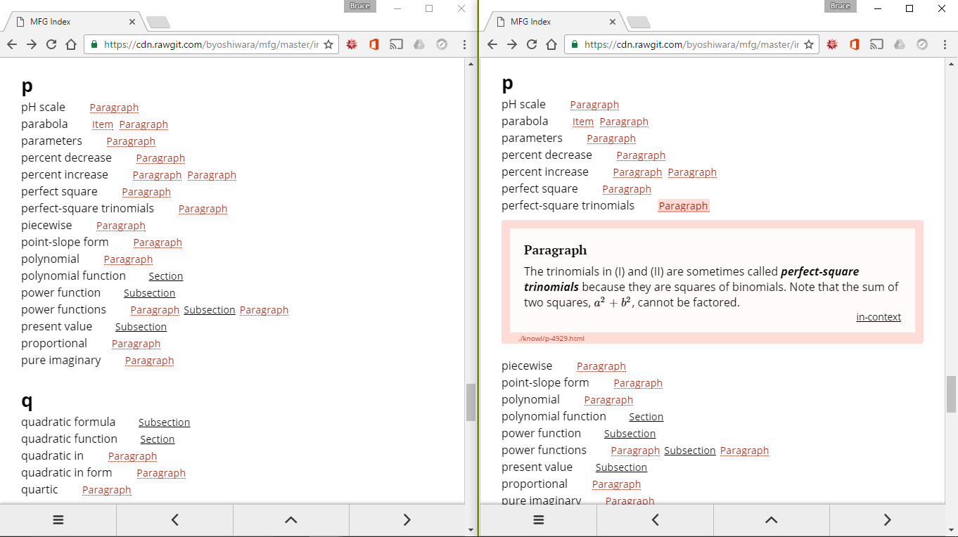
Knowls appear in place
Notes:
These are side-by-side tabs open to the same page of an index. I clicked on one of the terms to open a knowl. Which does not obscure any content, it moves the rest of the text further down the page.

Slide 9
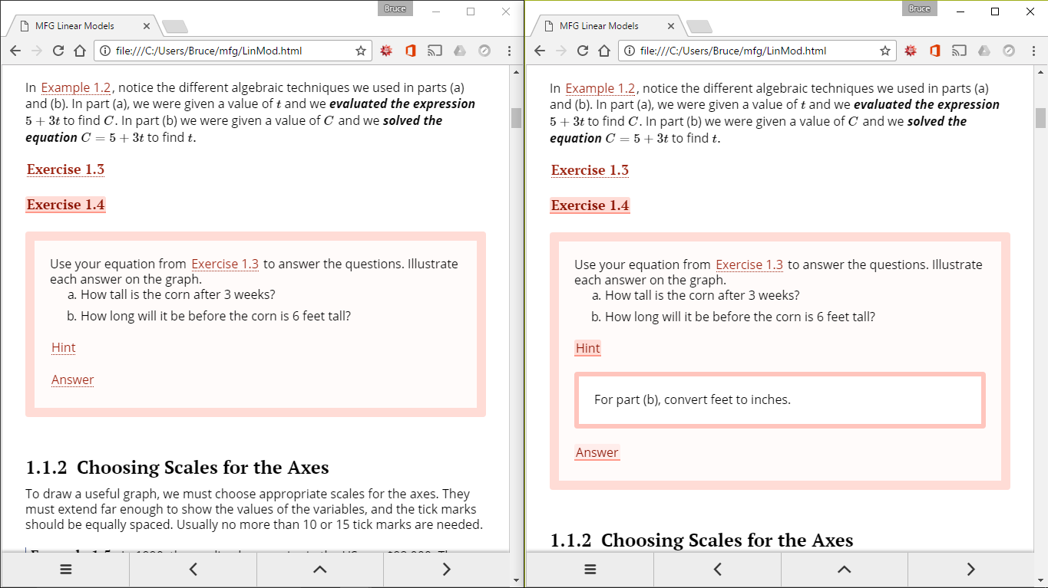
Knowls appear in place
Notes:
One of two exercise knowls is opened on the left—the nested “hint” knowl is open on the right.

Slide 10
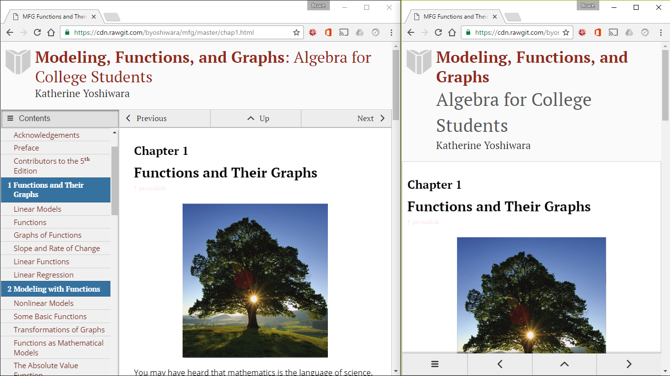
Textbook adjusts to display width
Notes:
By default, the book shows a navigation panel on the left which is the table of contents. But when the window is too narrow, the navigation bar disappears. Otherwise there are navigation buttons at the bottom.

Slide 11
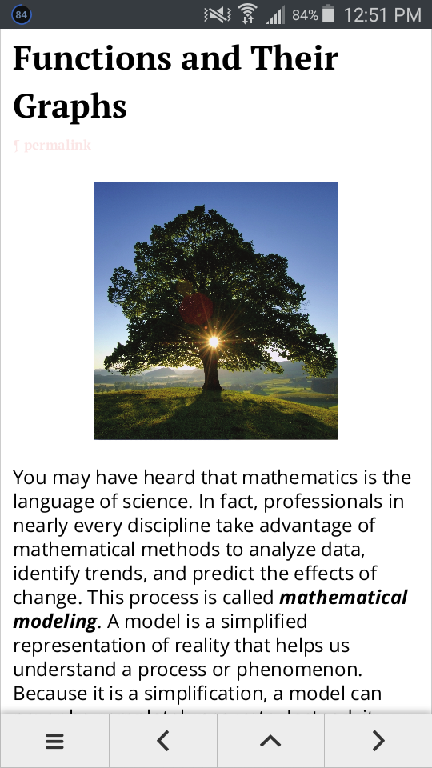
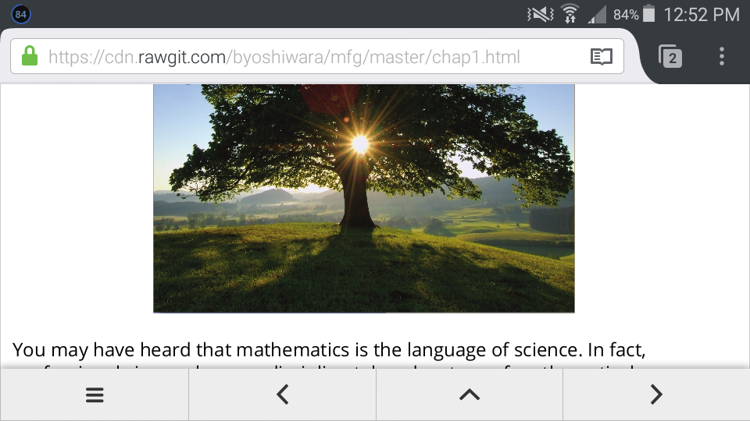
Textbook adjusts to display width
Notes:
On my phone both portrait and landscape mode are too narrow for the navigation panel on left. There are navigation buttons at the bottom, but when I really want the navigation bar, I can tap at the icon in the lower left.

Slide 12
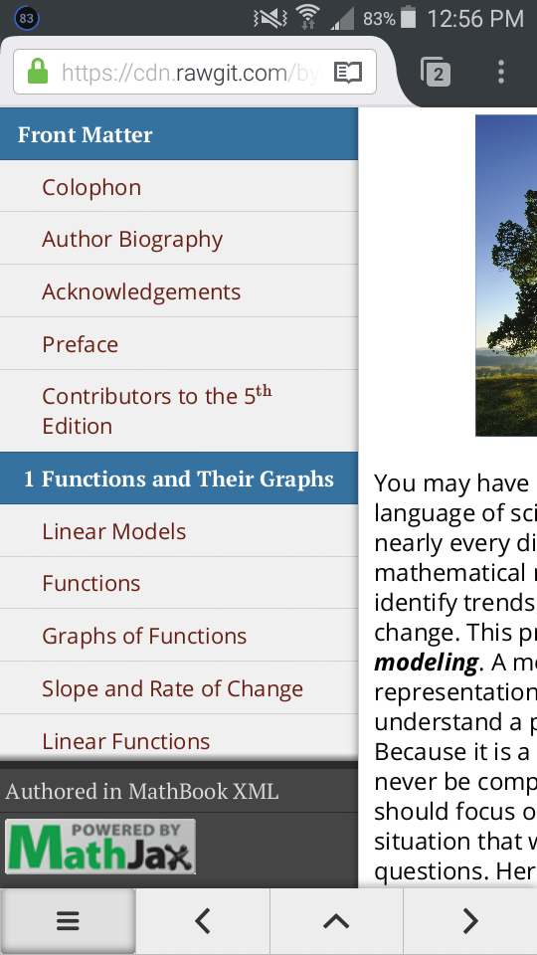
Textbook adjusts to display width
Notes:
The button on the bottom left opens the navigation panel—the navigation bar takes up a lot of display real estate. MBX and the AIM Open Textbook Initiative are two of four components of an NSF grant promoting the use of open software and open textbooks.

Slide 13
Undergraduate Teaching in Mathematics with Open Source Software and Textbooks (UTMOST)
The NSF grant-supported UTMOST project supports the Sage Cell server, SageMathCloud, MathBook XML, and AIM Open Textbook Initiative
Notes:
AIM Open Textbook Initiative and MBX are two parts of the NSF UTMOST grant. Another is the Sage Cell server, which makes it possible to embed the CAS Sage into a webpage.

Slide 14
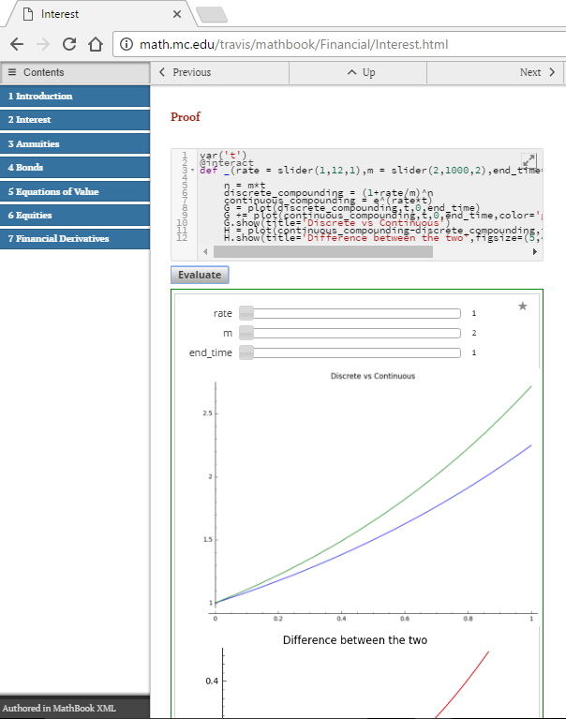
Sage cell server
Notes:
John Travis used MBX to create his class notes, and he included a Sage cell with commands. I clicked on Evaluate to reveal interactive graphics with slider buttons for the parameters..

Slide 15
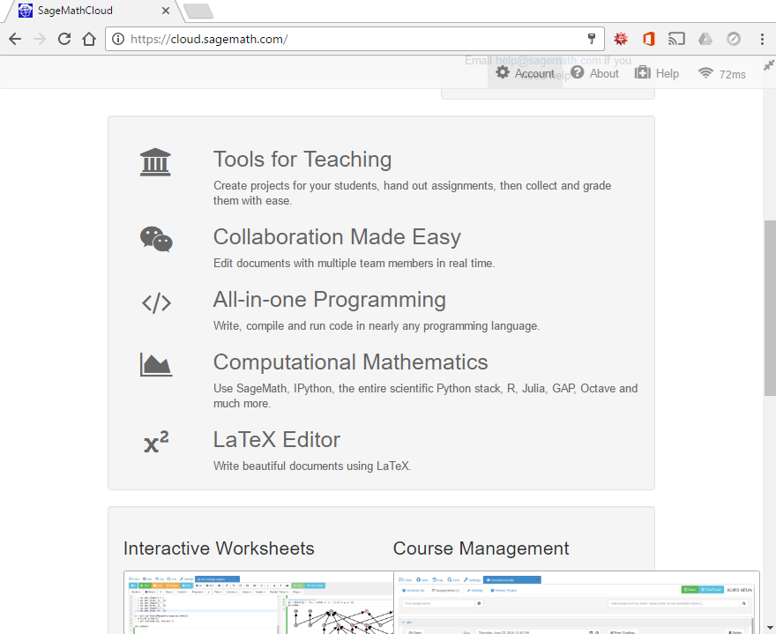
https://cloud.sagemath.com/
Notes:
The Sage math cloud is an online environment for teaching and learning math. We worked exclusively in the Sage math cloud for the first two days of the workshop.

Slide 16
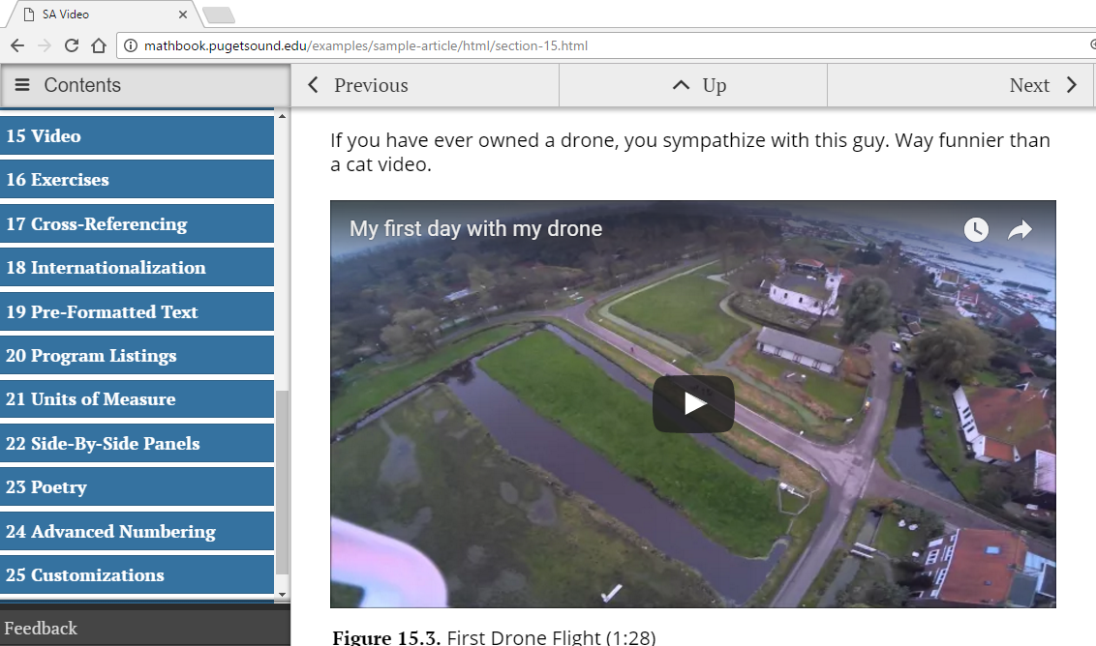
Embed video
Notes:
Essentially anything that you can put into a webpage can be put into your MBX html textbook. For example, some authors are embedding online homework exercises from the open source WeBWorK and some authors are embedding applets from the open source GeoGebra.

Slide 17
What do you need?
A computer with internet access
Time and willingness to learn
Notes:
You don’t need to buy anything to use Mathbook XML. Bob Plantz wrote his MBX CompSci textbook on a Raspberry Pi, being used this semester at Sonoma State and Santa Rosa JC .

Slide 18
What will you use?
A (plain) text editor to format content
A command line interface to convert your document into html and/or pdf
Mathbook XML support https://groups.google.com/forum/#!forum/mathbook-xml-support
GitHub to refresh your version of MBX and possibly to collaborate on your textbook
Notes:
You use a plain text editor to create your source, enter a command to transform that source file into html or pdf. You consult a google group for support, and you use GitHub to get the latest version of MBX and to keep track of your source files.

Slide 19
Find more information
American Institute of Mathematics (AIM) Open Textbook Initiative http://aimath.org/textbooks/
Mathbook XML (a.k.a. MBX) http://mathbook.pugetsound.edu/
Undergraduate Teaching in Mathematics with Open Source Software and Textbooks (UTMOST) http://utmost.aimath.org/
January 2017 Joint Math Meetings (Atlanta): OER sessions, MBX workshop, Electronic poster session
Notes:
There is an MBX workshop, and a CPS on OER with 3 or 4 MBX authors as presenters, and an electronic poster session with 3 or 4 MBX authors showing what they’re working on.

Slide 20
Thank you!
Bruce Yoshiwara
yoshiwbw@faculty.laccd.edu
Notes:
Besides Rob Beezer of U Puget Sound and David Farmer of AIM, the workhorse on MBX is Alex Jordan of Portland CC.

